Slide 1

Problem Statement: Cybersecurity Risk Assessment Framework for Small Businesses
Presented by: Atharva Lugade

Slide 2
Introduction
In today’s digital era, businesses rely heavily on information technology for operations, data storage, and services. While digital transformation improves efficiency, it also introduces significant cybersecurity risks. Small and Medium Enterprises (SMEs) are especially vulnerable due to limited resources, lack of expertise, and weak security infrastructure, making them common targets for threats like phishing, ransomware, malware, and data breaches.
These incidents can cause financial loss, reputational damage, legal issues, and operational disruption. As cyber threats evolve, SMEs must adopt a structured approach to identify, assess, and mitigate risks.
This project develops a scalable risk assessment model based on likelihood and impact to categorize risks and guide mitigation strategies. It also includes an Excel-based implementation for automated risk evaluation and uses case studies to validate its effectiveness.
Overall, the project demonstrates how a structured cybersecurity framework can help SMEs reduce risks, protect assets, and ensure business continuity.

Slide 3
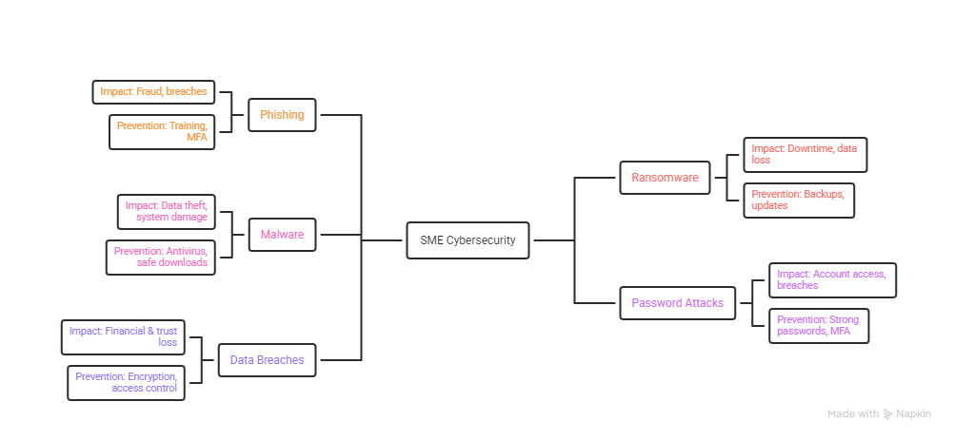
Research on some common cybersecurity risks

Slide 4
Risk Assessment Process
1. Identify Assets
List assets (data, systems)
Classify: Public → Critical
2. Assess Threats
Types: Natural, Technical, Human
Map threats to assets
3. Find Vulnerabilities
Weaknesses in systems/users
Example: Outdated software
4. Calculate Risk
Risk = Likelihood × Impact
Levels: Low → Critical
5. Rank Risks
Use risk matrix
Prioritize high-risk issues
6. Mitigate Risks
Avoid, Reduce, Transfer, Accept
Controls: Policies, firewalls, MFA
7. Monitor Risks
Continuous monitoring & audits
Detect new threats

Slide 5
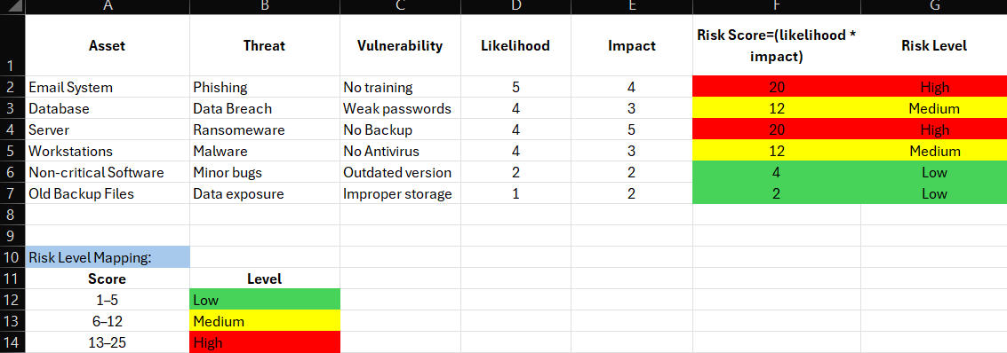
risk evaluation metric

Slide 6
Risk Assessment Table
Structure
Asset, Threat, Vulnerability
Likelihood (1–5), Impact (1–5)
Risk Score = L × I
Risk Level: Low / Medium / High
Risk Levels
🔴 High (13–25) → Immediate action 🟡 Medium (6–12) → Monitor & improve 🟢 Low (1–5) → Acceptable
Key Insights
High risk → Critical systems
Medium → Needs attention
Low → Low priority
Importance
Prioritizes risks
Improves decision-making
Enhances security posture

Slide 7
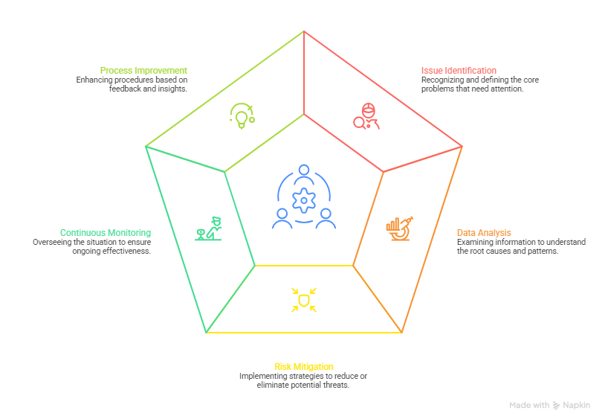
Risk Mitigation Strategies

Slide 8
What is Validation?
Testing model in real-world scenarios
Uses hypothetical SME case studies
Why It’s Important
Ensures model is practical
Shows real-world applicability
Identifies gaps/limitations
Highlights industry differences
Improves credibility

Slide 9
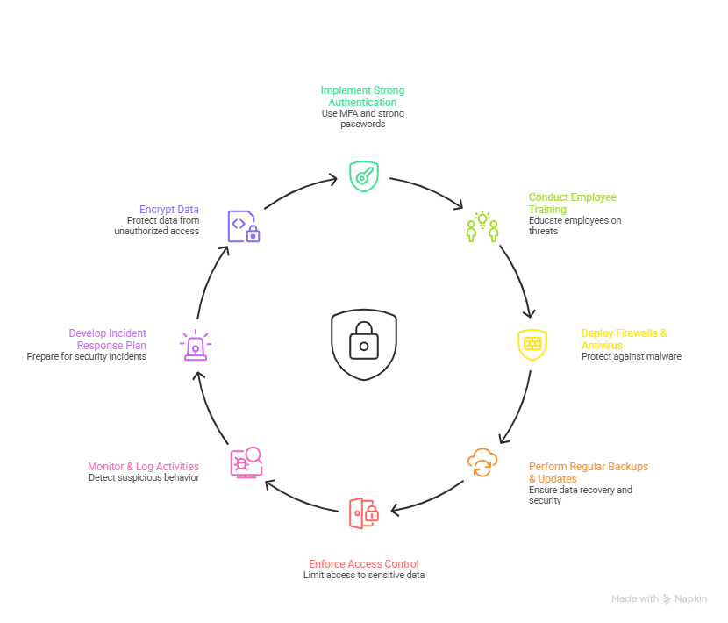
Document Findings for Best Practices for SME Cybersecurity
Findings
SMEs highly vulnerable to cyber threats
Common risks: Phishing, ransomware, malware
Model classifies risks: Low / Medium / High
Key Observations
High risk: Weak passwords, no MFA, outdated systems
Medium: Misconfigurations, poor monitoring
Low: Non-critical systems
Conclusion from Findings
Model identifies & prioritizes risks
Improves SME cybersecurity posture

Slide 10
reference
https://www.researchgate.net/publication/390626662_Ransomware_Attacks_on_Critical_Infrastructure_Effects_and_Prevention_Strategies
https://majmuah.com/journal/index.php/bij/article/view/458/224
https://www.ijert.org/research/ransomware-threats-IJERTCONV8IS15015.pdf

